Slide 1
HTTP, JSP, Servlet, Application Architecture
Application Architecture

Slide 2
Application Programs and User Interfaces
Web Fundamentals
Application Architectures
HTTP 1.1
n-Tier Enterprise Applications
Servlets and JSP

Slide 3
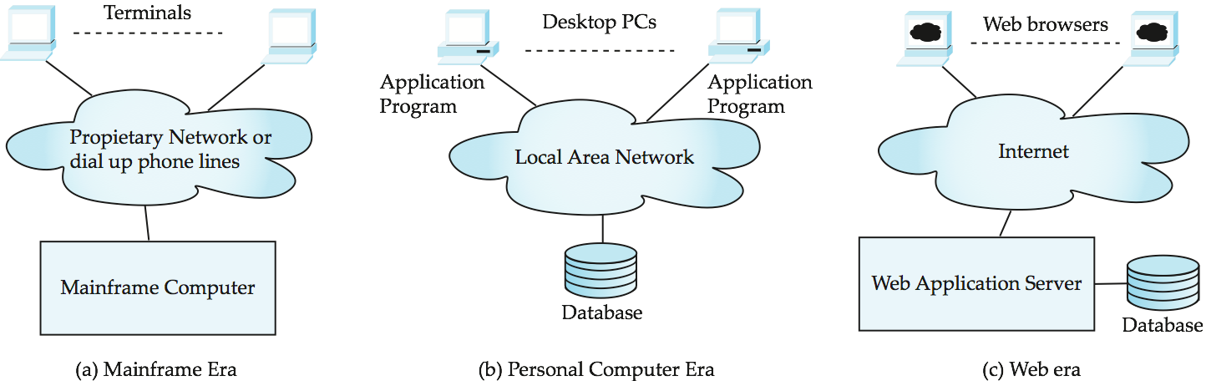
Application Architecture Evolution
Three distinct era’s of application architecture
mainframe (1960’s and 70’s)
personal computer era (1980’s)
C/S era (1990’s onwards)
Cluod (today …)

Slide 4
Web Interface
Web browsers have become the de-facto standard user interface to databases
Enable large numbers of users to access databases from anywhere
Avoid the need for downloading/installing specialized code, while providing a good graphical user interface
Javascript, Flash and other scripting languages run in browser, but are downloaded transparently
Examples: banks, airline and rental car reservations, university course registration and grading, an so on.

Slide 5
The World Wide Web
The Web is a distributed information system based on hypertext.
Most Web documents are hypertext documents formatted via the HyperText Markup Language (HTML)
HTML documents contain
text along with font specifications, and other formatting instructions
hypertext links to other documents, which can be associated with regions of the text.
forms, enabling users to enter data which can then be sent back to the Web server

Slide 6
Uniform Resources Locators
In the Web, functionality of pointers is provided by Uniform Resource Locators (URLs).
URL example:
http://www.acm.org/sigmod
The first part indicates how the document is to be accessed
“http” indicates that the document is to be accessed using the Hyper Text Transfer Protocol.
The second part gives the unique name of a machine on the Internet.
The rest of the URL identifies the document within the machine.
The local identification can be:
The path name of a file on the machine, or
An identifier (path name) of a program, plus arguments to be passed to the program
E.g., http://www.google.com/search?q=silberschatz

Slide 7
HTML and HTTP
HTML provides formatting, hypertext link, and image display features
including tables, stylesheets (to alter default formatting), etc.
HTML also provides input features
Select from a set of options
Pop-up menus, radio buttons, check lists
Enter values
Text boxes
Filled in input sent back to the server, to be acted upon by an executable at the server
HyperText Transfer Protocol (HTTP) used for communication with the Web server

Slide 8
Sample HTML Source Text
<html>
<body>
<table border> <tr> <th>ID</th> <th>Name</th> <th>Department</th> </tr> <tr> <td>00128</td> <td>Zhang</td> <td>Comp. Sci.</td> </tr> ….
</table>
<form action="PersonQuery" method=get> Search for: <select name="persontype"> <option value="student" selected>Student </option> <option value="instructor"> Instructor </option> </select> <br> Name: <input type=text size=20 name="name"> <input type=submit value="submit">
</form>
</body> </html>

Slide 9
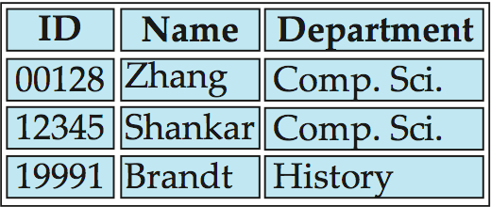
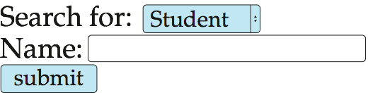
Display of Sample HTML Source

Slide 10
Web Servers
A Web server can easily serve as a front end to a variety of information services.
The document name in a URL may identify an executable program, that, when run, generates a HTML document.
When an HTTP server receives a request for such a document, it executes the program, and sends back the HTML document that is generated.
The Web client can pass extra arguments with the name of the document.
To install a new service on the Web, one simply needs to create and install an executable that provides that service.
The Web browser provides a graphical user interface to the information service.
Common Gateway Interface (CGI): a standard interface between web and application server

Slide 11
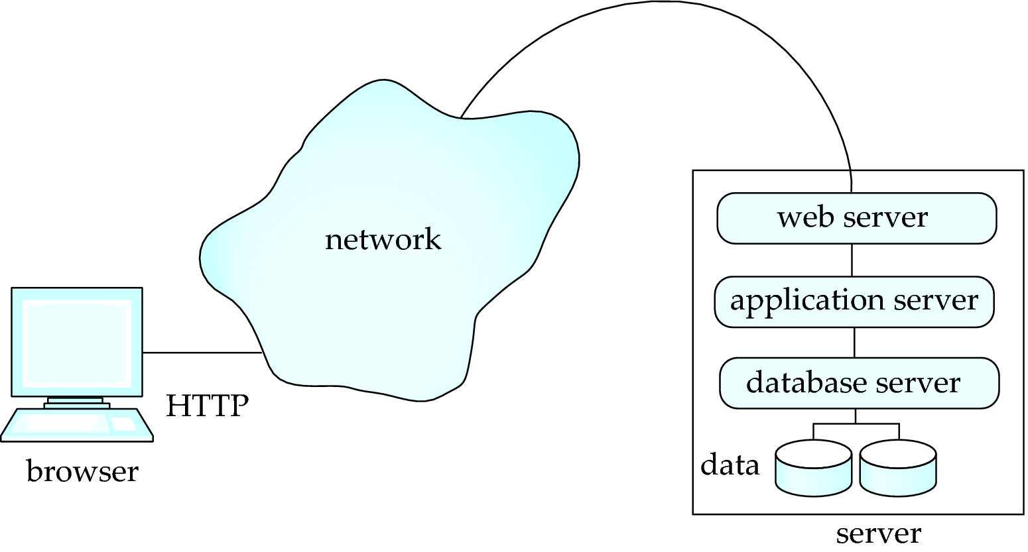
Three-Layer Web Architecture

Slide 12
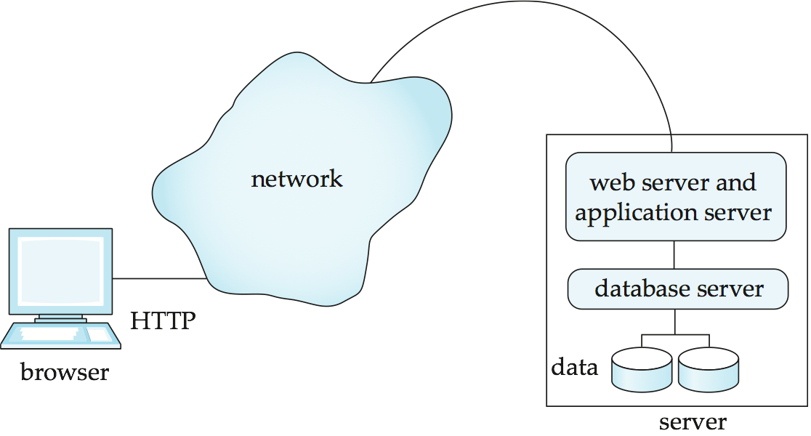
Two-Layer Web Architecture
Multiple levels of indirection have overheads
Alternative: two-layer architecture

Slide 13
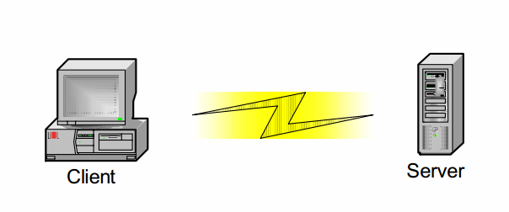
n-Tier Enterprise Applications
N = 2
client tier
 presents data to user, gathers data from user
server tier
 hosts application logic, databases, and data services

Slide 14
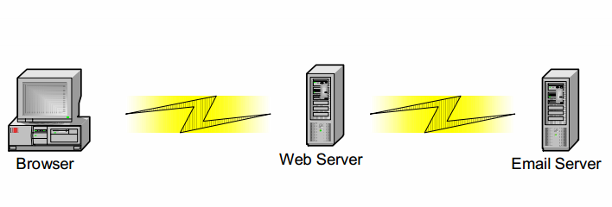
n-Tier Enterprise Applications
N = 3
client tier
 presents data to user, gathers data from user
Middle Tier
 hosts application logic
Back-End Tier
 hosts databases and data services

Slide 15
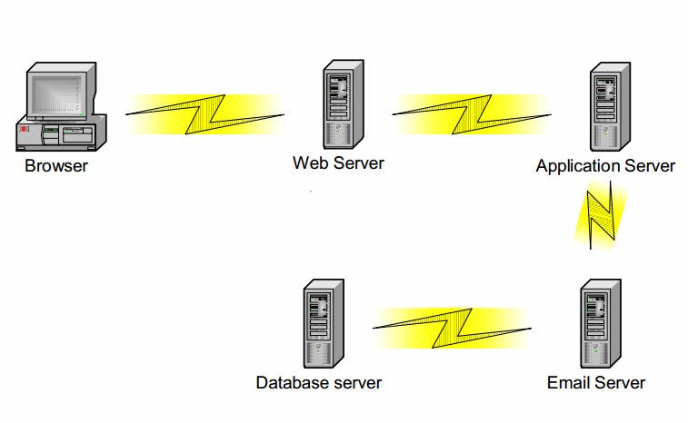
n-Tier Enterprise Applications
N = 5

Slide 16
n-Tier Enterprise Applications
XML
XML can be deployed at all tiers
XML on the Client
If the server communicates to the client self-describing, semantically tagged data in XML, then the client can
do more intelligent rendering with the help of stylesheets
present multiple views on the same data
take some processing load off the server
save many roundtrips to the server by caching data
Clients can even communicate data to other clients in XML!

Slide 17
n-Tier Enterprise Applications
XML
XML can be deployed at all tiers
XML in the Middle Tier
Middle-tier applications often intercommunicate by exposing emote objects
COM/DCOM objects expose COM interfaces but are bound to Microsoft platforms
EJBs expose Java interfaces via RMI but only allow Java clients
CORBA uses IDL interfaces and attempts to be platform-neutral
Content aggregation via XML
completely platform neutral
easy to use
easy to send over the network

Slide 18
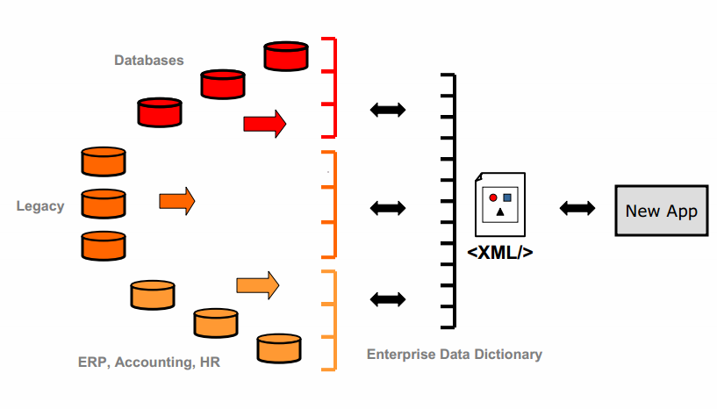
n-Tier Enterprise Applications
XML
XML can be deployed at all tiers
XML in the Middle Tier

Slide 19
n-Tier Enterprise Applications
XML
XML can be deployed at all tiers
XML in the Back-End Tier
The backend tier usually consists of databases and data services, including
relational databases
CRM (customer relationship management) applications
ERP (enterprise resource planning) applications
other legacy applications
The challenge is to enable middle-tier applications to access information from these data sources

Slide 20
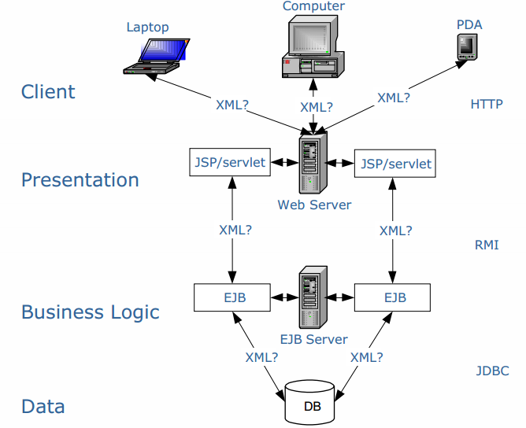
n-Tier Enterprise Applications
Typical J2EE Architecture

Slide 21
HTTP 1.1

Slide 22
HTTP and Sessions
The HTTP protocol is connectionless
That is, once the server replies to a request, the server closes the connection with the client, and forgets all about the request
In contrast, Unix logins, and JDBC/ODBC connections stay connected until the client disconnects
retaining user authentication and other information
Motivation: reduces load on server
operating systems have tight limits on number of open connections on a machine
Information services need session information
E.g., user authentication should be done only once per session
Solution: use a cookie

Slide 23
Sessions and Cookies
A cookie is a small piece of text containing identifying information
Sent by server to browser
Sent on first interaction, to identify session
Sent by browser to the server that created the cookie on further interactions
part of the HTTP protocol
Server saves information about cookies it issued, and can use it when serving a request
E.g., authentication information, and user preferences
Cookies can be stored permanently or for a limited time
Cookies help the server keeping state of the session
Today cookies Identifiers are used (sessions) and created by the server (Sessions and Sessions ids)
Data is actually stored at the server’s memory

Slide 24
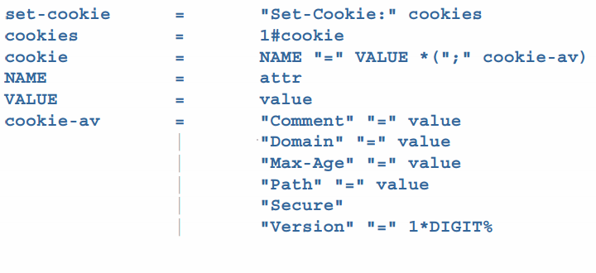
HTTP 1.1
Cookies

Slide 25
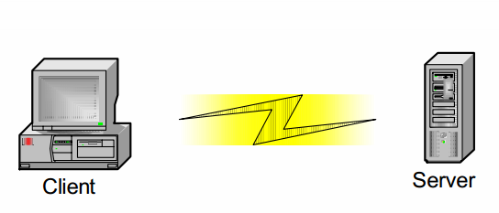
HTTP 1.1
Request Methods
GET
POST
TCP Ports
HTTP is an application protocol used to request web pages.
An HTTPS message sent from the browser to the server
Example of GET
Get / HTTP/1.0
This request the default page on the root directory
Hyper references indicate to the server to fetch additional resources (image, style sheet, file, etc.)
Src=“/logo.jpg”

Slide 26
HTTP 1.1
Request Methods
GET
POST
TCP Ports
POST hides some of the information and does not send the request in the URL
Still data is sent in text in the HTTP message
Useful to send binary files (upload)
Pinterest, Facebook, Instagram, etc

Slide 27
HTTP 1.1
TCP/IP
TCP
Guarantee of deliver (Reliable transmit protocol )
Keep sending the message until it gets to the destination server
TCP also identifies different services on the server using ports
Port # come from TCP
Webserver Port 80
SMTP Port 25
DNS Port 50
MySQL Port 3306
IP
IP describes every computer on the internet with an IP address
And enable communication to other computers using the IP address

Slide 28
Java Servlet

Slide 29
Java Servlets
“A servlet is a Java™ technology-based Web component, managed by a container, that generates dynamic content.
Like other Java-based components, Servlets are platform-independent Java classes that are compiled to platform-neutral byte code that can be loaded dynamically into and run by a java-enabled web server.
Java Servlet specification defines an API for communication between the Web/application server and application program running in the server
E.g., methods to get parameter values from Web forms, and to send HTML text back to client

Slide 30
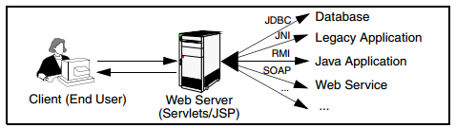
Servlets
Servlets are Java programs that run on Web or application servers, acting as middle layer between requests coming from Web browser (HTTP) and application (database) on the HTTP server

Slide 31
Java Servlets
What is a Servlet Container?
“The servlet container is a part of a Web server or pplication server that provides the network services over which requests and responses are sent, decodes MIME-based requests, and formats MIME-based responses.
A servlet container also contains and manages servlets through their lifecycle.”
Java Servlet Containers
Apache Tomcat
BEA WebLogic Server
IBM WebSphere Application Server
JBoss Application Server
Oracle Application Server
Glassfish

Slide 32
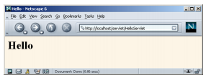
Java Servlet Example: HelloServlet.java
import java.io.*;
import javax.servlet.*;
import javax.servlet.http.*;
public class HelloServlet extends HttpServlet {
public void doGet(HttpServletRequest request, HttpServletResponse response)
throws ServletException, IOException {
response.setContentType("text/html");
PrintWriter out = response.getWriter();
String docType = "<!DOCTYPE HTML PUBLIC \"-//W3C//DTD HTML 4.0 " +
"Transitional//EN\">\n";
out.println(docType +
"<HTML>\n" +
"<HEAD><TITLE>Hello</TITLE></HEAD>\n" +
"<BODY BGCOLOR=\"#FDF5E6\">\n" +
"<H1>Hello</H1>\n" +
"</BODY></HTML>");
}
}

Slide 33
Example Servlet Code
import java.io.*;
import javax.servlet.*;
import javax.servlet.http.*;
public class PersonQueryServlet extends HttpServlet {
public void doGet (HttpServletRequest request, HttpServletResponse response)
throws ServletException, IOException
{
response.setContentType("text/html");
PrintWriter out = response.getWriter();
out.println("<HEAD><TITLE> Query Result</TITLE></HEAD>");
out.println("<BODY>");
….. BODY OF SERVLET (next slide) …
out.println("</BODY>");
out.close();
}
}

Slide 34
Example Servlet Code
String persontype = request.getParameter("persontype");
String number = request.getParameter("name");
if(persontype.equals("student")) {
... code to find students with the specified name ...
... using JDBC to communicate with the database ..
out.println("<table BORDER COLS=3>");
out.println(" <tr> <td>ID</td> <td>Name: </td>" + " <td>Department</td> </tr>");
for(... each result ...){
... retrieve ID, name and dept name
... into variables ID, name and deptname
out.println("<tr> <td>" + ID + "</td>" + "<td>" + name + "</td>" + "<td>" + deptname + "</td></tr>");
};
out.println("</table>");
}
else {
... as above, but for instructors ...
}

Slide 35
Servlet: Typical Sequence of Events
A client (e.g., a Web browser) accesses a Web server and makes an HTTP request.
The request is received by the Web server and handed off to the servlet container.
The servlet container can be running in the same process as the host web server, in a different process on the same host, or on a different host from the web server for which it processes requests.
The servlet container determines which servlet to invoke based on the configuration of its servlets, and calls it with objects representing the request and response.
Web.xml configuration file (URLs to Java Servlet code)
The servlet uses the request object to find out who the remote user is, what HTTP POST parameters may have been sent as part of this request, and other relevant data. The servlet performs whatever logic it was programmed with, and generates data to send back to the client. It sends this data back to the client via the response object.
Once the servlet has finished processing the request, the servlet container ensures that the response is properly flushed, and returns control back to the host Web server.

Slide 36
Servlet Sessions
Servlet API supports handling of sessions
Sets a cookie on first interaction with browser, and uses it to identify session on further interactions
To check if session is already active:
if (request.getSession(false) == true)
.. then existing session
else .. redirect to authentication page
authentication page
check login/password
request.getSession(true): creates new session
Store/retrieve attribute value pairs for a particular session
session.setAttribute(“userid”, userid)
session.getAttribute(“userid”)

Slide 37
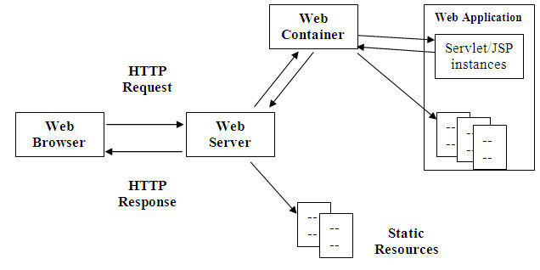
Web Servers
Outputs and receives HTML

Slide 38
Server-Side Scripting
JSP

Slide 39
Server-Side Scripting
Server-side scripting simplifies the task of connecting a database to the Web
Define an HTML document with embedded executable code/SQL queries.
Input values from HTML forms can be used directly in the embedded code(SQL queries).
When the document is requested, the Web server executes the embedded code to generate the actual HTML document.
Numerous server-side scripting languages
JSP, PHP
General purpose scripting languages: VBScript, Perl, Python

Slide 40
JSP
JSP is HTML pages with Java code embedded inside of them
a JSP document is just another way of writing a servlet.
JSP pages get translated into servlets, the servlets get compiled, and it is the servlets that run at request time.
JSP And Servlets are essentially the same thing
JSP is focused on simplifying the creation and maintenance of the HTML.
Servlets are best at invoking the business logic and performing complicated operations.
A quick rule of thumb is that servlets are best for tasks oriented toward processing, whereas JSP is best for tasks oriented toward presentation
You can think of servlets as Java code with HTML inside;
you can think of JSP as HTML with Java code inside

Slide 41
JSP Programming
To make JSP page more interactive we can read and process the data entered in a an HTML form.
request.getParameter method
Takes the name of the HTML field name as parameter
Returns the value entered by the user
String authorName = request.getParameter (“AuthorName”);

Slide 42
Java Server Pages (JSP)
A JSP page with embedded Java code
<html>
<head> <title> Hello </title> </head>
<body>
<% if (request.getParameter(“name”) == null)
{ out.println(“Hello World”); }
else
{ out.println(“Hello, ” + request.getParameter(“name”)); }
%>
</body>
</html>
JSP is compiled into Java + Servlets

Slide 43
JSP Programming
JSP Elements
All of these elements are identified by their own tags
Declarations
These tags allows you to define variables and methods
<%!
private int count = 0;
private void increments () { count ++;}
%>
Expressions
We can access variables and methods
<p> The value of Count is : <%= count %> </p>
Scriptlets
Blocks of Java code
<% out.println (“Hello Students”); %> //out is already defined in javax.servlet.jsp.JspWriter
<%
out.println(“The counter =“ + count + <br />);
incrementCount();
%>
Directives
Instructions on how to process a JSP program (Importing packages)
<%@ page import=“java.util.*,java.sql.*” %>

Slide 44
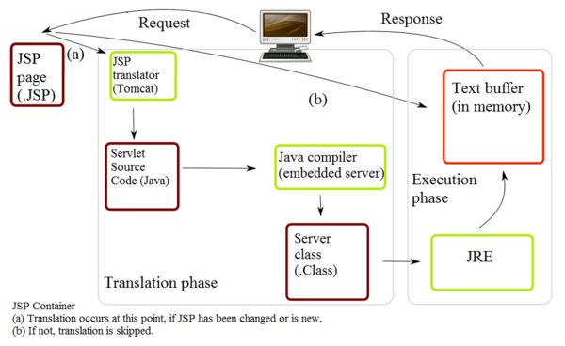
Running JSP Program
JSP Servlets Engine
JSP/Servlet engine dynamically compiles the JSP source code into Servlet if a current compiled Servlet does not exist

Slide 45
PHP
PHP is widely used for Web server scripting
Extensive libaries including for database access using ODBC
<html>
<head> <title> Hello </title> </head>
<body>
<?php
if (!isset($_REQUEST[‘name’]))
{ echo “Hello World”; }
else
{ echo “Hello, ” + $_REQUEST[‘name’]; }
?>
</body>
</html>

Slide 46
Client Side Scripting
Javascript, JQuery

Slide 47
Client Side Scripting
Browsers can fetch certain scripts (client-side scripts) or programs along with documents, and execute them in “safe mode” at the client site
Javascript / JQuery
Macromedia Flash and Shockwave for animation/games
Applets
Client-side scripts/programs allow documents to be active
E.g., animation by executing programs at the local site
E.g., ensure that values entered by users satisfy some correctness checks
Permit flexible interaction with the user.
Executing programs at the client site speeds up interaction by avoiding many round trips to server
Notes:
47

Slide 48
Client Side Scripting and Security
Security mechanisms needed to ensure that malicious scripts do not cause damage to the client machine
Easy for limited capability scripting languages, harder for general purpose programming languages like Java
E.g., Java’s security system ensures that the Java applet code does not make any system calls directly
Disallows dangerous actions such as file writes
Notifies the user about potentially dangerous actions, and allows the option to abort the program or to continue execution.
Notes:
48

Slide 49
Javascript
Javascript very widely used
forms basis of new generation of Web applications (called Web 2.0/3.0 applications) offering rich user interfaces
Javascript functions can
check input for validity
modify the displayed Web page, by altering the underling document object model (DOM) tree representation of the displayed HTML text
communicate with a Web server to fetch data and modify the current page using fetched data, without needing to reload/refresh the page
forms basis of AJAX technology used widely in Web 2.0 applications
E.g. on selecting a country in a drop-down menu, the list of states in that country is automatically populated in a linked drop-down menu

Slide 50
Javascript
Example of Javascript used to validate form input
<html> <head> <script type="text/javascript"> function validate() { var credits=document.getElementById("credits").value; if (isNaN(credits)|| credits<=0 || credits>=16) { alert("Credits must be a number greater than 0 and less than 16"); return false } } </script>
</head>
<body> <form action="createCourse" onsubmit="return validate()"> Title: <input type="text" id="title" size="20"><br /> Credits: <input type="text" id="credits" size="2"><br /> <Input type="submit" value="Submit"> </form>
</body>
</html>

Slide 51
Application Architectures

Slide 52
Application Architectures
Application layers
Presentation or user interface
model-view-controller (MVC) architecture
model: business logic
view: presentation of data, depends on display device
controller: receives events, executes actions, and returns a view to the user
business-logic layer
provides high level view of data and actions on data
often using an object data model
hides details of data storage schema
data access layer
interfaces between business logic layer and the underlying database
provides mapping from object model of business layer to relational model of database

Slide 53
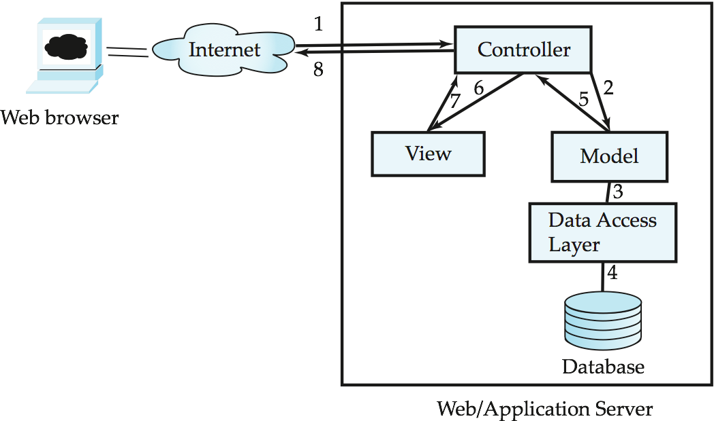
Application Architecture

Slide 54
Business Logic Layer
Provides abstractions of entities
e.g. students, instructors, courses, etc
Enforces business rules for carrying out actions
E.g. student can enroll in a class only if she has completed prerequsites, and has paid her tuition fees
Supports workflows which define how a task involving multiple participants is to be carried out
E.g. how to process application by a student applying to a university
Sequence of steps to carry out task
Error handling
e.g. what to do if recommendation letters not received on time
Workflows discussed in Section 26.2

Slide 55
Object-Relational Mapping
Allows application code to be written on top of object-oriented data model, while storing data in a traditional relational database
alternative: implement object-oriented or object-relational database to store object model
Schema designer has to provide a mapping between object data and relational schema
e.g. Java class Student mapped to relation student, with corresponding mapping of attributes
An object can map to multiple tuples in multiple relations
Application opens a session, which connects to the database
Objects can be created and saved to the database using session.save(object)
mapping used to create appropriate tuples in the database
Query can be run to retrieve objects satisfying specified predicates

Slide 56
Object-Relational Mapping and Hibernate (Cont.)
The Hibernate object-relational mapping system is widely used
public domain system, runs on a variety of database systems
supports a query language that can express complex queries involving joins
translates queries into SQL queries
allows relationships to be mapped to sets associated with objects
e.g. courses taken by a student can be a set in Student object
See book for Hibernate code example
The Entity Data Model developed by Microsoft
provides an entity-relationship model directly to application
maps data between entity data model and underlying storage, which can be relational
Entity SQL language operates directly on Entity Data Model

Slide 57
Web Services
Allow data on Web to be accessed using remote procedure call mechanism
Two approaches are widely used
Representation State Transfer (REST): allows use of standard HTTP request to a URL to execute a request and return data
returned data is encoded either in XML, or in JavaScript Object Notation (JSON)
Big Web Services:
uses XML representation for sending request data, as well as for returning results
standard protocol layer built on top of HTTP

Slide 58
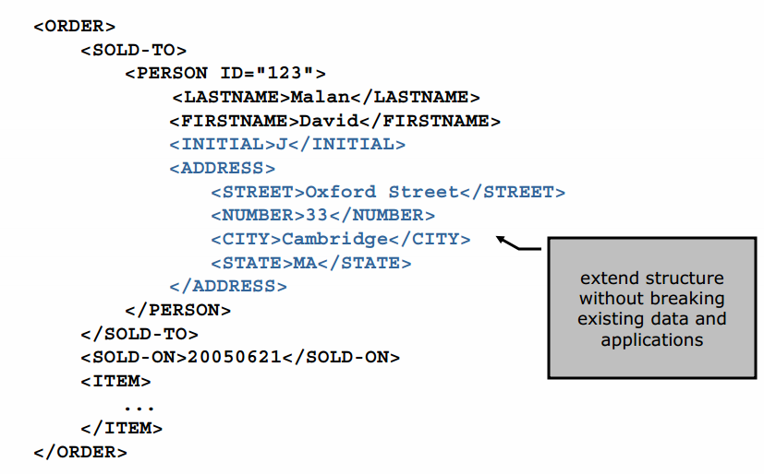
XML

Slide 59
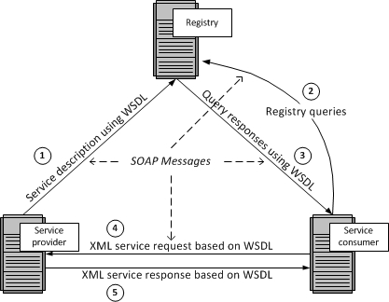
Web Services Description Language (WSDL)
The repository shown in the above figure could be a UDDI registry
A service provider describes its service using WSDL. This definition is published to a repository of services. The repository could use Universal Description, Discovery, and Integration (UDDI). Other forms of directories could also be used.
A service consumer issues one or more queries to the repository to locate a service and determine how to communicate with that service.
Part of the WSDL provided by the service provider is passed to the service consumer. This tells the service consumer what the requests and responses are for the service provider.
The service consumer uses the WSDL to send a request to the service provider.
The service provider provides the expected response to the service consumer.
All the messages shown in the above figure are sent using SOAP

